Slide 1

HASHING
LESSON 17
CFGDEGREE → FULL-STACK STREAM

Slide 2

AGENDA
01 Hashing concept explained
02 Hashing method in Python explained
03 Practice and coding

Slide 3
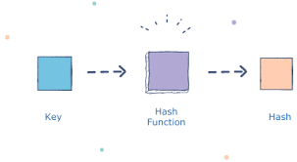
HASHING
Let’s watch a DEMO to understand the concepts of HASHING
Notes:
Use : https://www.autodraw.com/ as your drawing board to explain HASHING concepts
Watch the instructor video GUIDE 1 for example explanations.

Slide 4
HASHING REFERENCE
A hash table (dictionary in Python) organizes data so you can quickly look up values for a given key.
Think of a hashmap as a "hack" on top of an array to let us use flexible keys instead of being stuck with sequential integer "indices."
Hashing function - is a function to convert a key into an array index (an integer).
Hash collision - a situation where two keys hash to the same index in the array
Dealing with collision - instead of storing the actual values in the array, make each array slot to hold a pointer to a linked list (box) holding the values for all the keys that hash to that index.
SYNONYMS
Hash
Hashmap
Map
Unordered map Dictionary

Slide 5

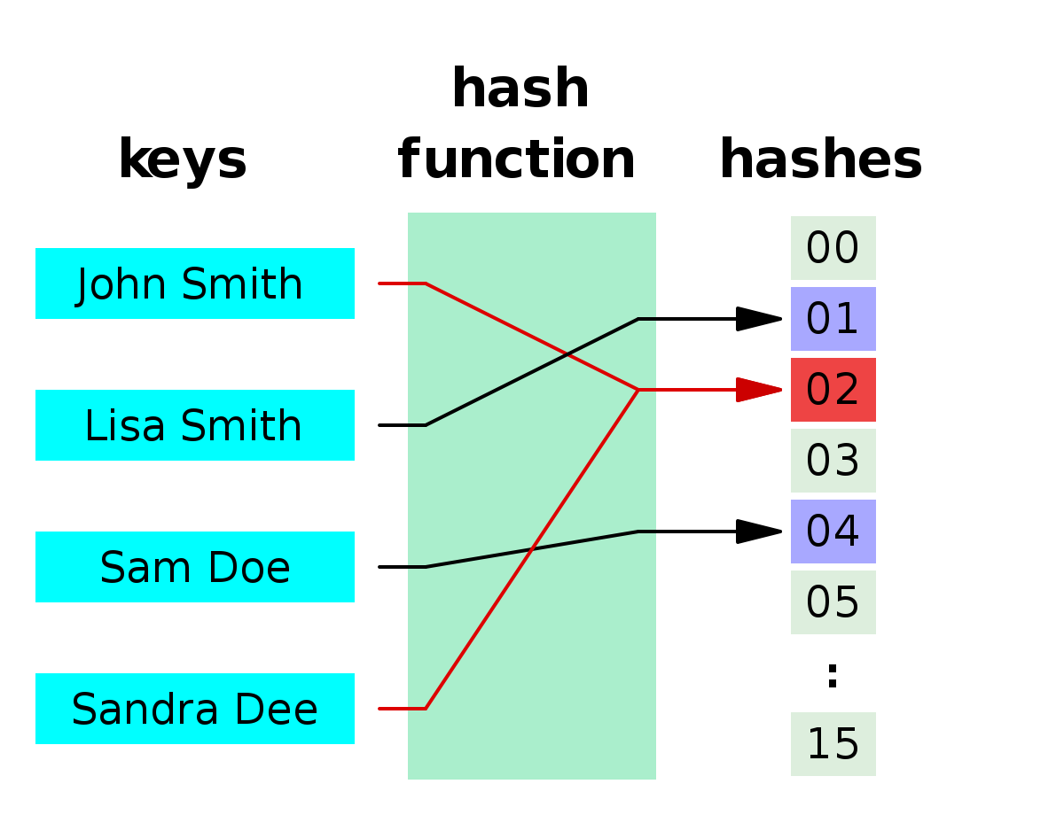
Regarding Hash Collisions
Again, a quick overview of what it is and strategies to deal with it
# HASH COLLISION EXAMPLE
No hashing mechanism is unfortunately perfect - even with the use of fancy mathematics and prime numbers, there’s always the potential of a hash collision (instance where two data entities have the same hash value)
Collisions can just occasionally happen - pure chance is higher than you think. Consider for example The Birthday Paradox - you only need 23 people in a room for 2 of them to have the same birthday. 70 people in a room, and it’s 99% chance two have the same birthday.
As a result, we use some common hash collision strategies to resolve this; we’ll take a quick look at two common ones!

Slide 6
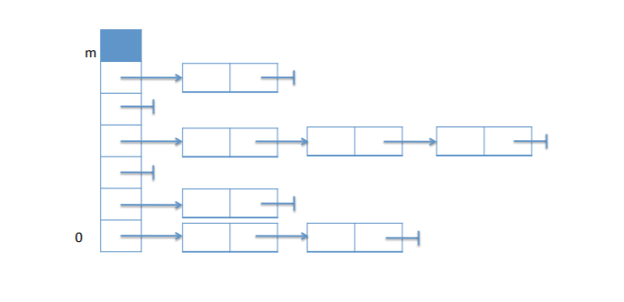
Collision Strategy 1: Separate Chaining
Simple & elegant
The first collision strategy is ‘Separate Chaining’ - in essence, we just store more at the collision site.
At collision sites, we effectively just add in a Linked List at that location - and add the next value in the adjacent linked list node
If someone wants to search for a value given a hash, and that hash has had a lot of collisions, all they’d have to do is a linear search of the linked list nodes connected to that site!
This strategy is really easy to implement, but it uses more memory (for the linked lists). Plus, if the linked chain becomes too long, then it’s O(N) look-up anyway (since I have to search N linked list nodes! It renders the benefit of Hashing’s O(1) look-up null).
# EXAMPLE

Slide 7
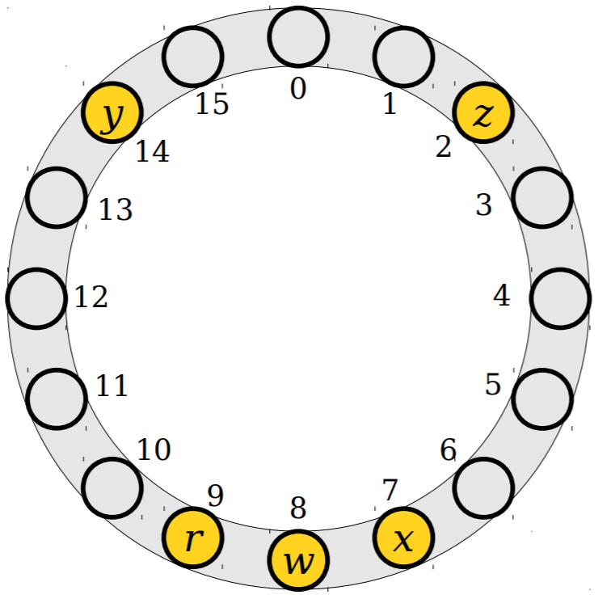
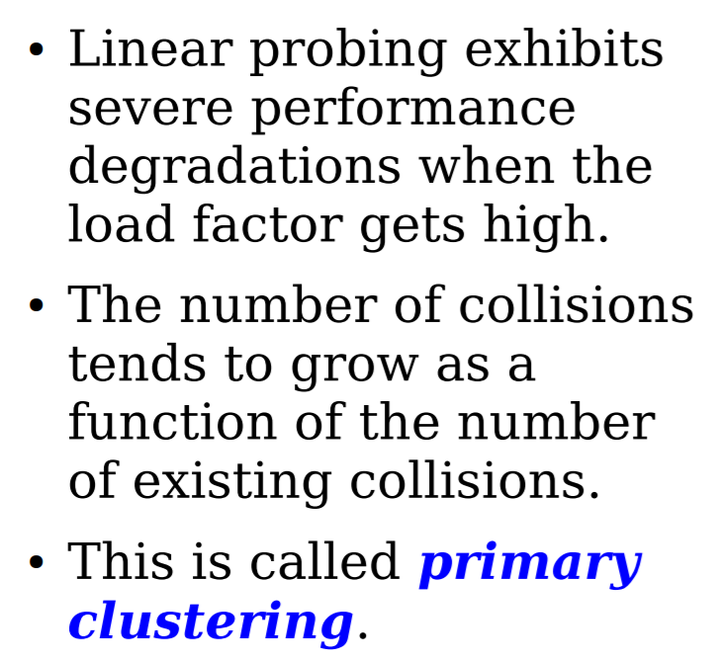
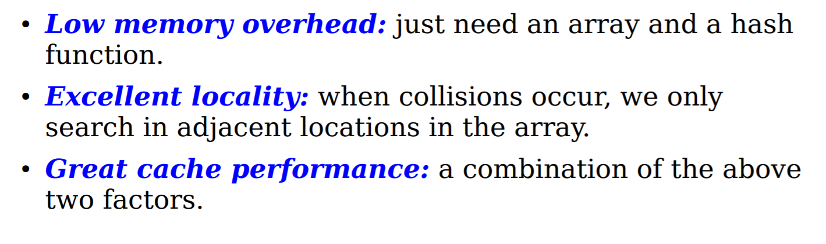
Collision Strategy 2: Linear Probing
Also known as Open Addressing
# FROM MIT LECTURE NOTES
The idea of Linear Probing is: I have a hash table, and there’s bound to be some empty corners and spaces in it. If I get a hash collision, why not just place the element in the next adjacent free slot?
When I need to do a look-up, and it’s not at the place I expected it to be (as it's in the other free slots), I just have to do a linear search (going adjacent) until I find it! And if I return to my starting position, then I know the element doesn’t exist.
This saves an amazing amount of memory (no extra use, just re-use what you have) though it is difficult to implement + you could cause the table to actually get full - what happens when this occurs? You could get a literal self-catalysing collisions situation occurring!
# DIAGRAM, DISADV (RIGHT) AND ADV (BELOW)

Slide 8

HASH METHOD IN PYTHON
Let’s watch a DEMO to understand the concepts of HASH METHOD
Notes:
Use : https://www.autodraw.com/ as your drawing board to explain HASH method
Watch the instructor video GUIDE 2 for example explanations.

Slide 9

DEMO &
EXERCISES
HASHING IMPLEMENTATION
EXERCISES & PRACTICE

Slide 10

THANK YOU!
Hashing Summarised:
Output
Relaxing Image
Hash Function

